Slide 1
Banking System
Login Page & Main
Customer Entry
Deposit Entry
Withdrawals Entry
Account Type
Transaction

Slide 2
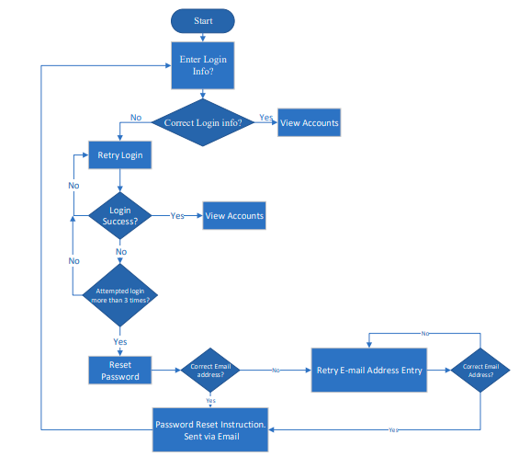
Online Banking System

